Slide 1

College of Veterinary Medicine
Veterinary Parasitology
BY
Prof. Dr. Suzan A. Al-azizz

Slide 2

Cryptosporidium spp.
Protozoan
Phylum: Apicomplexa
Class: Sporozoasida
Order: Eucoccidiida
Family Cryptosporiidae
Genus: Cryptosporidium
Species: parvum, muris, meleagridis, felis,

Slide 3

Why Do Cryptosporidium Matter
Disease and Death
Zoonotic Potential
Production Loss

Slide 4
Cryptosporidium is a spore producing parasite found in the intestine of infected people and animals and Cryptosporidium spp. is the most common cause of Cryptosporidiosis. Recognized in mice in 1907 Reported in humans in 1976 Immuno competent child Immuno suppressed adult, Recognized globally in 1980s and 1990s between AIDS patients.
Cryptosporidium is a microscopic parasite that causes the diarrheal disease cryptosporidiosis. Both the parasite and the disease are commonly known as “ Crypto.”
There are many species of Cryptosporidium that infect animals, some of which also infect humans.

Slide 5
The parasite is protected by an outer shell that allows it to survive outside the body for long periods of time and makes it very tolerant to chlorine disinfection. While this parasite can be spread in several different ways, water (drinking water and recreational water) is the most common way to spread the parasite. Cryptosporidium is a leading cause of waterborne disease among humans in different parts of world. There are at least 32 ‘valid’ Cryptosporidium species , some of which cause disease in humans , livestock , poultry and game birds, and companion animals.

Slide 6
Cryptosporidiiae family
This family includes one genus, Cryptosporidium, which is a parasite that spreads over a wide range of mammals, birds, reptiles and fish. This parasite is one of the types of coccidiosis, but it differs from it by the absence of spore sacs, but rather there are four spores inside the egg sac. It parasites in intestinal epithelia or respiratory epithelia in its host. Many species and genotypes of the apicomplexan

Slide 7
protozoan Cryptosporidium can infect humans and have a wide range of host animals. Zoonotic species and genotypes of Cryptosporidium are those transmitted from animal hosts to humans, and non-zoonotic species and genotypes are host-adapted without evidence of transmission from animals to humans. Cryptosporidium parvum and C. hominis are the leading causes of human cryptosporidiosis. C. meleagridis, C. felis, C. canis, C. ubiquitum, C. cuniculus, C. viatorum, Chipmunk genotype I, Cryptosporidium mink genotype, and C. muris can also infect humans.

Slide 8
Geographic Range:
Zoonotic and non-zoonotic Cryptosporidium spp. and genotypes are ubiquitous worldwide. Outbreaks of cryptosporidiosis have been and continue to be reported in several countries . Cryptosporidiosis outbreaks in the U.S. have been linked to swimming pools, water playgrounds, and other swimming venues; unpasteurized cider, juice, and milk; contact with animals; childcare settings; camps; and ill food handlers.

Slide 9
The egg sacs are elliptical and contain 1-8 granules and each sachet contains 4 thin spores. When the cysts are swallowed with drinking water, the spores emerge in the intestine and penetrate its epithelia to occur there, reproduction and growth to expel the egg sacs 5 days after the start of infection
Life Cycle
The life cycle of C. parvum is depicted below and begins with ingestion of the sporulated oocyst, the resistant stage found in the environment. Each oocyst contains 4 infective stages termed sporozoites,

Slide 10
which exit from a suture located along one side of the oocyst. The preferred site of infection is the ileum, and sporozoites penetrate individual epithelial cells in this region. Parasites reside on the lumenal surface of the cells, and they were once thought to occur extracellularly. However, ultrastructural observations have clearly shown these parasites to be intracellular, enclosed by a thin layer of host cell cytoplasm. A unique, desmosome-like attachment organelle, plus accessory foldings of the parasite membranes,

Slide 11
develop at the interface between the parasite proper and the host cell cytoplasm. This attachment organelle is sometimes referred to as the "feeder organelle." Multiple fission (=merogony; =schizogony) occurs, resulting in the formation of 8 merozoites within the meront. These meronts are termed Type I meronts and rupture open, releasing free merozoites. Once these merozoites penetrate new cells, they undergo merogony to form additional meronts. Type I merozoites are thought to be capable of recycling indefinitely and, thus, the potential exists for new Type I meronts to arise continuously.

Slide 12
It is thought that some Type I merozoites are somehow triggered into forming a second type of meront, the Type II meront, which contains only 4 merozoites. Once liberated, the Type II merozoites appear to form the sexual stages. Some Type II merozoites enter cells, enlarge, and form macrogametes (=macrogametocyte). Others undergo multiple fission once inside cells, forming microgametocytes containing 16 non-flagellated microgametes. Microgametes rupture from the microgametocyte and penetrate macrogametes, thus forming a zygote. A resistant oocyst wall is then formed around the zygote (the only diploid stage in the life cycle), meiosis occurs, and 4 sporozoites are formed in the process.

Slide 13
Formation of sporozoites is termed sporogony. These oocysts are passed in the feces and into the environment. Approximately 20% of the oocysts produced in the gut fail to form an oocyst wall and only a series of membranes surround the developing sporozoites. These "oocysts," devoid of a wall, are sometimes termed "thin-walled oocysts." It is believed that the resulting sporozoites produced from thin-walled oocysts can excyst while still within the gut and infect new cells. Thus, C. parvum appears to have two auto infective cycles: the first by continuous recycling of Type I meronts and the second through sporozoites rupturing from thin-walled oocysts.

Slide 14
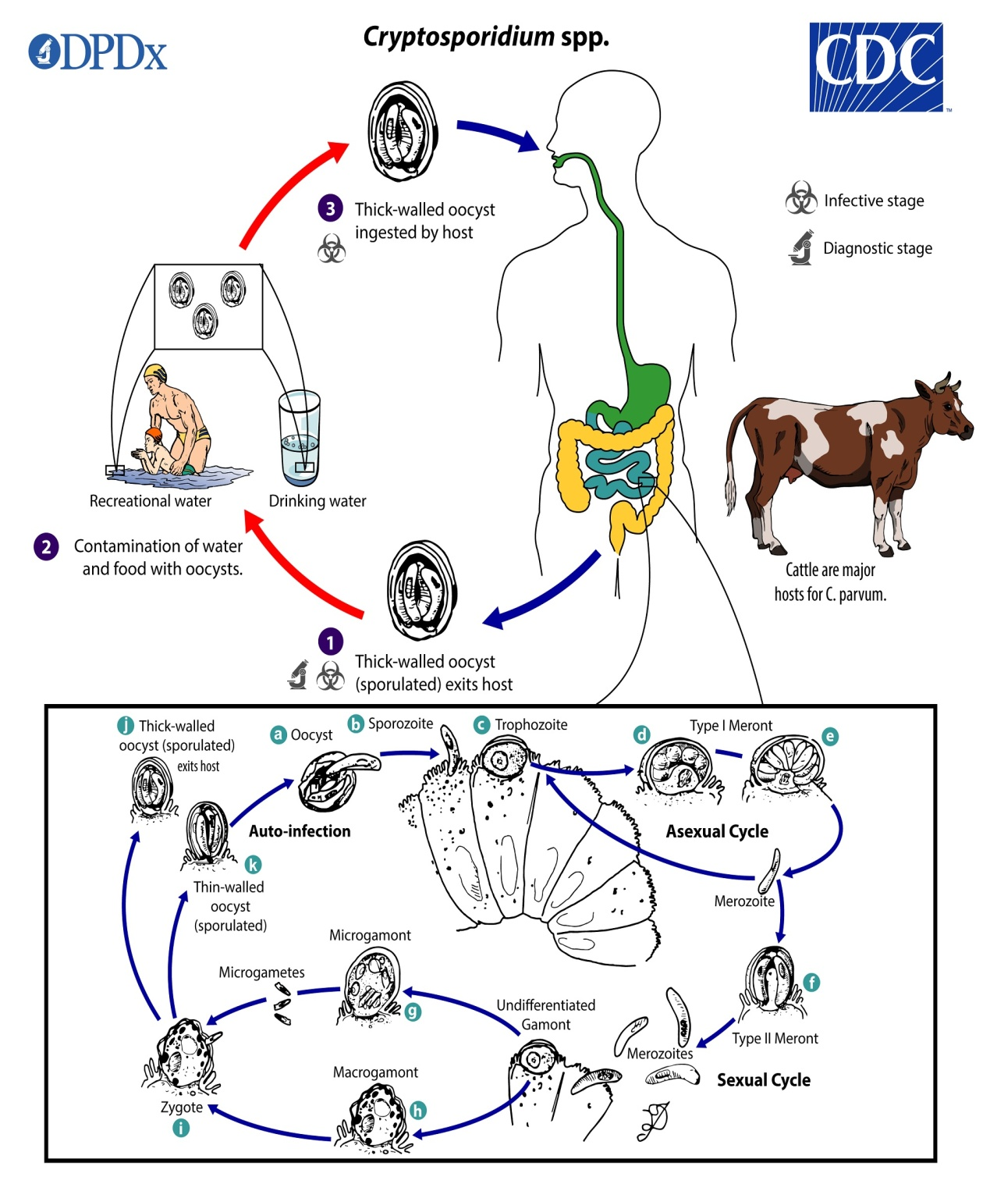

Slide 15
Cryptosporidium tyzzeri It parasitizes domesticated chickens and has a wide spread, whereby all the evolutionary roles outside the cells are on the tiny villi of epithelial cells in the tubular part of the caecum, and this type does not share pathogencity.
Cryptosporidium meleagridis It parasites on domesticated turkeys because it causes diarrhea and death. Parasites are observed on the epithelium of the intestine and the tissues are not invaded by them. Egg sacs are oval in shape and the internal development cycle includes an asexual generation that results in metastases and molecules. Young cells are based on their presence in the lymphocytes, spleen and lymph nodes.

Slide 16
Clinical Signs
Infection with Cryptosporidium spp. and genotypes results in a wide range of signs and symptoms. The incubation period is an average of 7 days (range: 2–10 days). Immunocompetent patients may present with diarrheal illness that is self-limiting, typically resolving within 2–3 weeks. Immunocompromised patients may have more severe complications, such as life-threatening malabsorption and wasting. Diarrheal illness may be accompanied by fever or fatigue). While the small intestine is primarily affected, extraintestinal cryptosporidiosis (e.g., in the pulmonary or biliary tract, rarely in the pancreas) has been reported.

Slide 17
How is cryptosporidiosis diagnosed?
Cryptosporidiosis is usually diagnosed when cryptosporidium is found in your stool (faeces) after a sample is sent to the laboratory. Occasionally, in people with a weakened immune system and a negative stool sample, cryptosporidium may be detected after a biopsy of the stomach or bowel. A biopsy is a procedure which involves taking a small sample of tissue from the body so that it can be looked at in detail.

Slide 18
What is the treatment for cryptosporidiosis?
Most people with cryptosporidiosis do not need any specific medication or treatment. Their immune system will usually work to clear the infection. Some studies have shown that medicines such as nitazoxanide may help clear symptoms more quickly in some people. However, this medicine is not routinely used in the UK. More evidence is needed regarding possible medicines to treat cryptosporidium infection.
If you have cryptosporidiosis, there are things that you can do to ease your symptoms and to help avoid complications while your immune system is doing the work. Most importantly, you should make sure that you drink plenty of fluids. The aim is to prevent lack of fluid in the body (dehydration), or to treat dehydration if it has developed. Once any dehydration is corrected, you should eat as normally as possible.

Slide 19
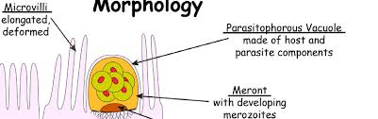
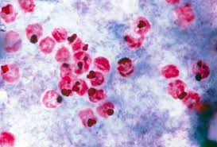
Oocysts of Cryptosporidium parvum

Slide 20
THANK YOU

